Slide 1

Final Project Review
on
Capstone(Major) Project
MCA-4th Semester
May-2019

Slide 2
COMPANY NAME-
COGNIZANT TECHNOLOGY SOLUTION
PROJECT TITLE -
POLICY TRACKER- (POLICY SYSTEM)
MADE BY - PRINCE (17MCA10005)
Under Supervision
INTERNAL GUIDE EXTERNAL GUIDE
Dr. P.S PATHEJA Mrs. Shilpa Mahajani
Associate Professor Project Manager
(VIT Bhopal University) (Cognizant Technology
Solution)

Slide 3
Project Abstract
This is the web based Application Software for the client which is a insurance company So, Success of any insurance company relies on its ability to assess the risk before issuing a policy to a customer based on their needs and ensure the policies are designed to meet the customer necessities.
Insurance company’s customer needs to be able to search, enroll for a policy, edit policy details, renew a policy.
The solution developed will address this objective in a holistic manner and will have all the features and functionalities which will allow its customer to search for policies available with the vendors, choose the policy based on the requirements and enroll for a policy. The customer will also be allowed to edit the policy premium payments details from quarterly to yearly or monthly. The customer can also raise requests to renew the policies and perform online payments. This enables insurance companies a transparent system to build confidence in the customer and provides increased success.

Slide 4
Organization Profile

Slide 8
Introduction
This Project is aimed at:
• This Project is about the admin and user login in which they would manage and access policies as required.
• This project is about Policy Management System where the user/admin end would login to buy, delete and edit policies as per the access rights.
•The admin would enter valid credentials in login page to enter the admin home page and buy, remove, add and search policies.
•Similarly the user would enter valid credentials in login page to enter the user home page and buy, remove and search policies.
The purpose of this document is to systematically capture requirements for the project and the system to be developed. The document also captures the Functional requirements and serves as an input for the scope of project.

Slide 9
Proposed System and its Advantages
This Project is aimed at:
This Project is about the admin and user login in which they would manage and access policies as required.
This project is about Policy Management System where the user/admin end would login to buy, delete and edit policies as per the access rights.
The admin would enter valid credentials in login page to enter the admin home page and buy, remove, add and search policies.
Similarly the user would enter valid credentials in login page to enter the user home page and buy, remove and search policies.

Slide 11
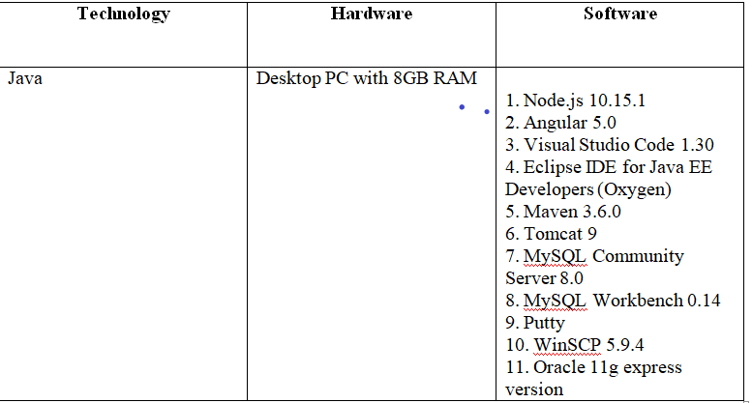
Hardware & Software Requirement

Slide 12
Technology Used
Front End:- Java (HTML5, CSS3, JavaScript, Angular,JSTL)
Middleware :- Java (Spring, Spring MVC, Hibernate MVC, WEB API2)
Backend :- MYSQL Server

Slide 13
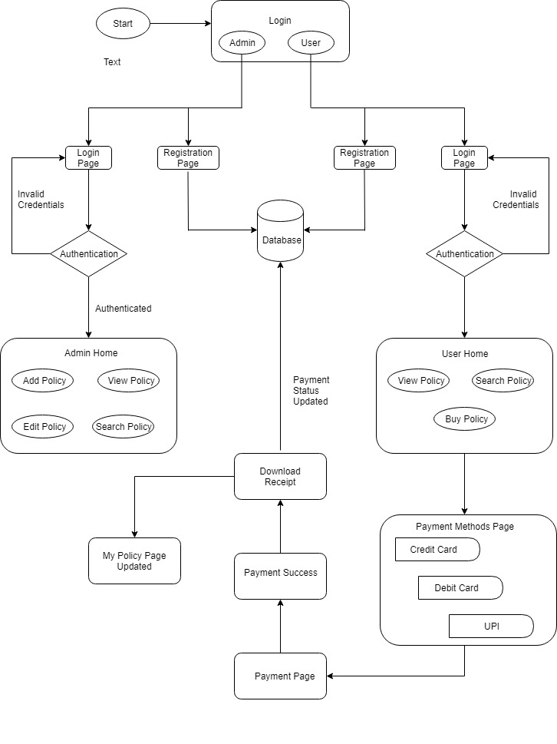
System Design(Work Flow Diagram)

Slide 14
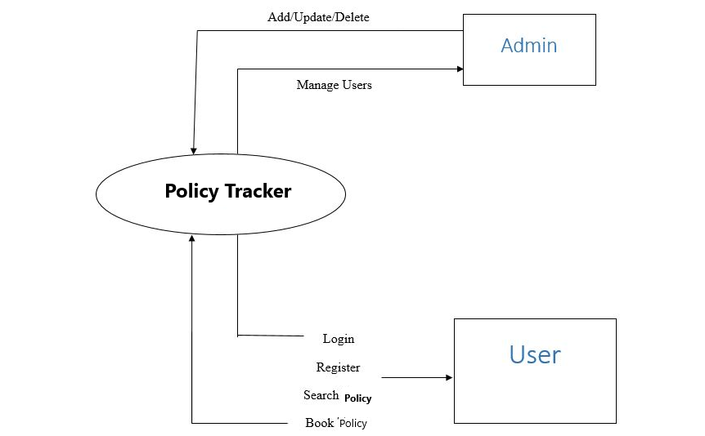
Data Flow Diagram(0 Level Diagram)

Slide 15
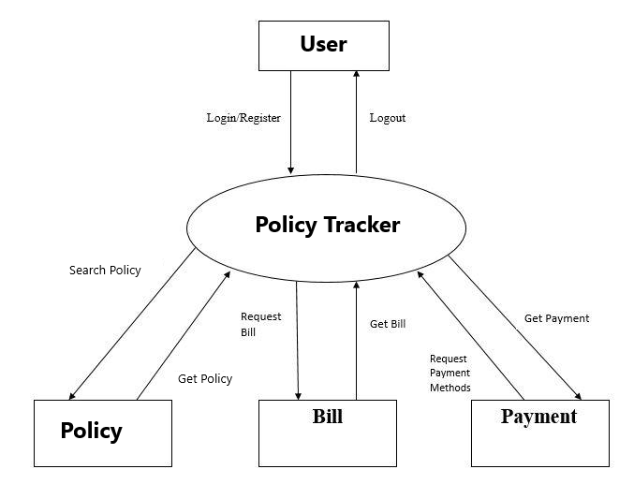
Data Flow Diagram(1st Level Diagram)

Slide 16
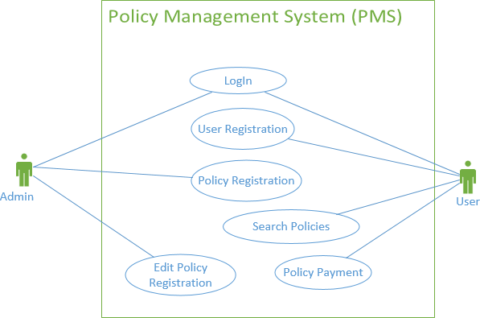
Use Case

Slide 17
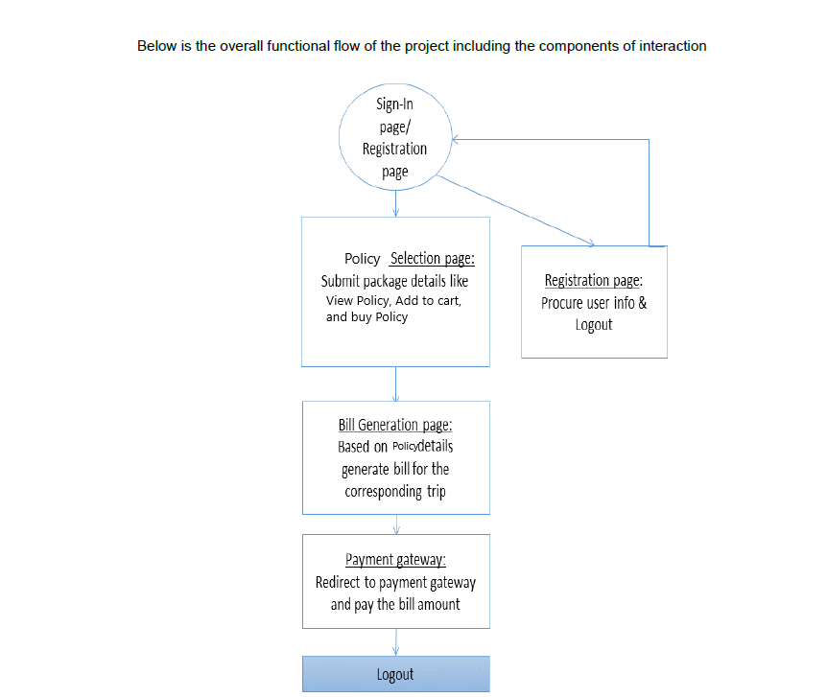
Process Architecture

Slide 18
MODULE OF THE SYSTEM
Policy Management System
(Policy Tracker)
Admin
Client
Create Policy
update policy
Check the Policy
Take action
Add Policy
Create account
View Policy
Buy Policy
Payment of Policy

Slide 19
Advantage of Application
Less human error
Strength and strain of manual labour can be reduced
High security
Data redundancy can be avoided to some extent
Data consistency
Easy to handle
Easy data updating
Easy record keeping
Backup data can be easily generated

Slide 20
Tables
1.User Info
Field Name | Field Type | Data Type | Mandatory | Possible Values
First Name | Text(50) | Alphabetic | Yes
Last Name | Text(50) | Alphabetic | Yes
DOB | Text(10) | DD/MM/YYYY | Yes
Gender | Drop Down | NA |  | Male, Female
Contact Number | Text(10) | Numeric | Yes
Address | Text(60) | Alphanumeric | Yes
Email Id | Text(15) | Alphanumeric | Yes
Qualification | Text(10) | Alphanumeric | Yes
Salary per Month | Numeric(10) | Numeric | Yes
PAN No | Text(10) | Alphanumeric | Yes
Employer type | Text(10) | Alphanumeric | No
Employer | Text(10) | Alphanumeric | No
Hint Question | Text(50) | Alphanumeric | Yes
Hint Answer | Text(50) | Alphanumeric | Yes
Password | Text(15) | Alphanumeric | Yes

Slide 21
2.Policy Info
Field Name | Field Type | Data Type | Mandatory | Possible Values
Policy Id | Text(10) | Alphanumeric | Yes
Policy | Text(50) | AlphaNumeric | Yes
Name
Policy type | Text(10) | AlphaNumeric | Yes
Company | Text(50) | AlphaNumeric
Initial Deposit | Text(10) | Numeric | Yes
User type | Text(10) | Alphanumeric | Yes
Term amount | Text(15) | Numeric | Yes
Interest | Text(2) | Numeric | Yes
Duration of years | Text(2) | Numeric | Yes

Slide 22
3.UserPolicy
Field Name | Field Type | Data Type | Mandatory | Possible Values
SR No. | Numeric(10) | Numeric | Yes | SR No
User Id | Text(10) | Alphanumeric | Yes | User
Policy Id | Text(10) | Alphanumeric | Yes | Policy Id
Payment Status | Text(10) | Alphanumeric | Yes | Payment status

Slide 23
4.BillDetail
Field Name | Field Type | Data Type | Mandatory | Possible Values
SR No | Numeric(10) | Numeric | Yes | SR No.
User Id | Text(10) | Alphabetic | Yes | User Id
User Name | Text(10) | Alphabetic | Yes | User Name
Payment Mode | Text(10) | NA | Male, Female | Payment Mode
Card No. | Text(10) | Numeric | Yes | Card No.
CVV | Numeric | Alphanumeric | Yes | CVV
Expiry | Numeric | Alphanumeric | Yes | Expiry
Password | Password(10) | Alphanumeric | Yes | Password

Slide 24
Future Scope
In future, This project can be more feasible to the client, Insurance Company can plan to that type of project where client can create his own policy according to his requirement and Policy portal will the tell price of customize policy of client which is created by client.
REMAINING AREAS OF CONCERN
There are still, after a lot of efforts, the areas of concern in the project. Once the user is registered there is no way to edit the user details. In future release we can add this feature to the project.

Slide 25
Conclusion
The current status of our project is that all modules like login, home page, add new candidate page, edit details page, view all candidate page of the project are completed and their design, coding and testing are done. The application is completely developed and tested.
TECHNICAL AND MANAGERIAL LESSONS LEARNT
We have learnt a lot of things while developing the project.
Working with the Eclipse IDE.
Working with server-side tasks.
Style website using Bootstrap Framework.
Connect Database with the web application.
Creating and managing databases using MYSQL and using it in Spring.
Working in a team and co-ordination among them.
Problem Analysis and problem solving with the team mates.

Slide 26
References
[1] https://www.tutorialspoint.com
[2] https://getbootstrap.com/docs/4.1/getting-started/introduction/
[3] https://www.javatpoint.com
[4] https://www.w3schools.com/bootstrap4/
[5] Hands-On Full Stack Development with Spring Boot 2.0 and React: Build modern and scalable full stack applications using the Java-based Spring Framework 5.0 and React 1st Edition, Kindle

Slide 27
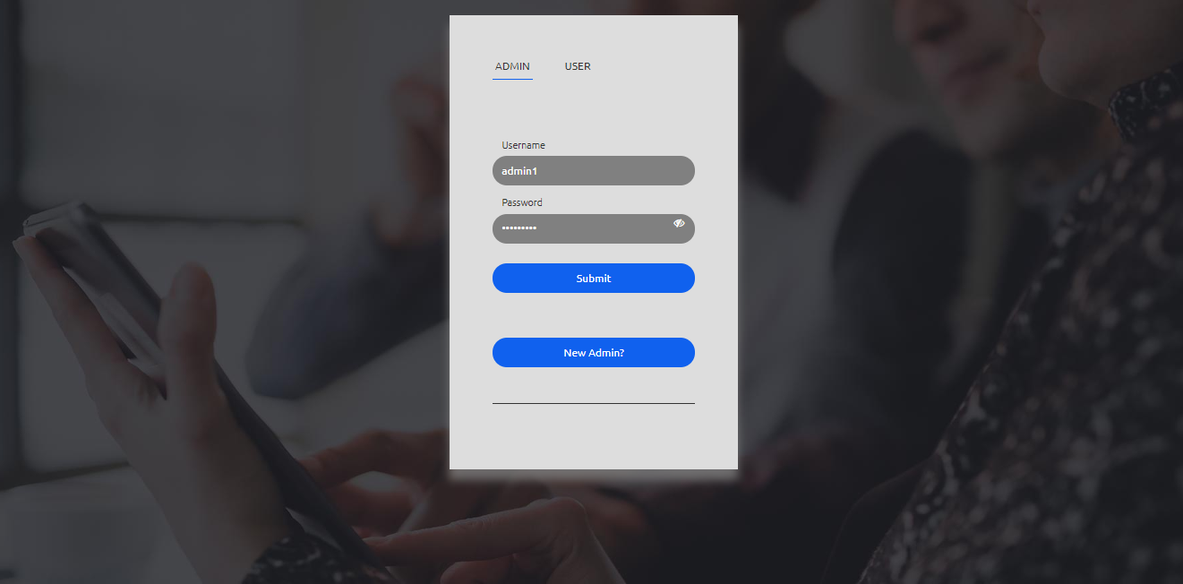
Screenshot
Login Page

Slide 28
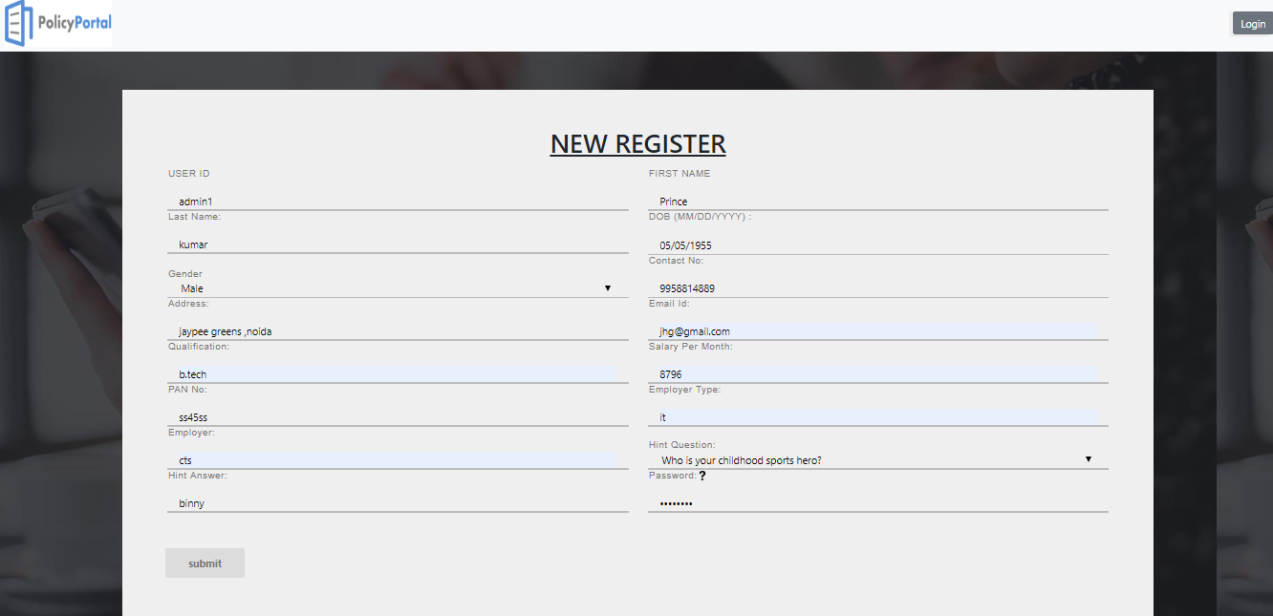
Registration Page

Slide 29
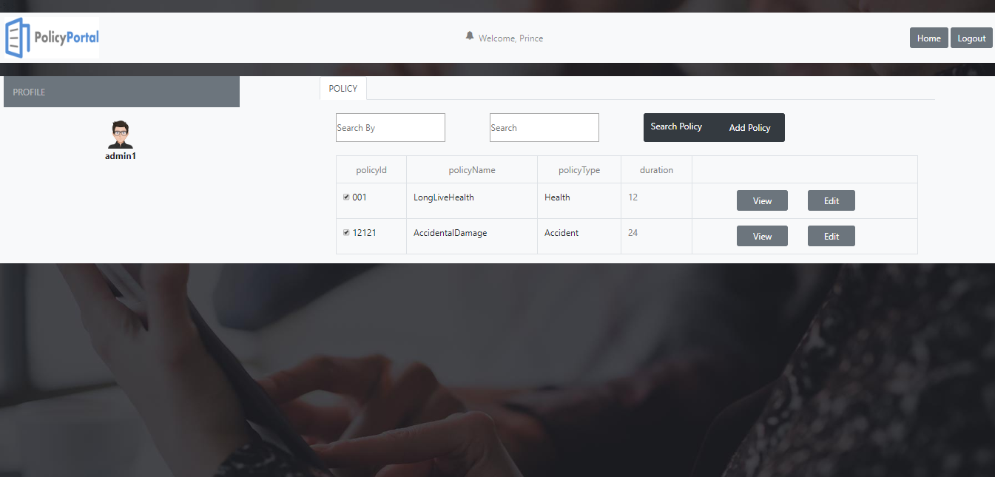
Admin Dashboard

Slide 30
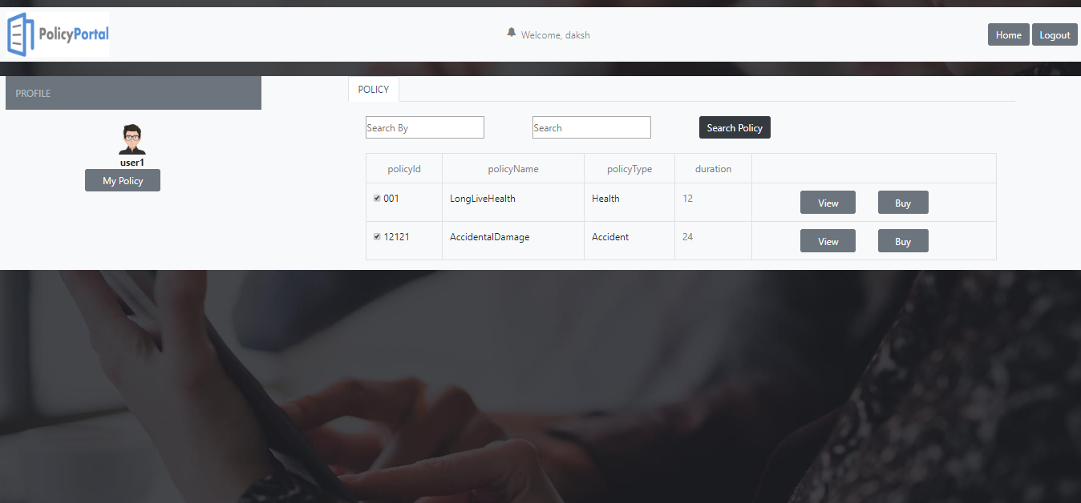
User Dashboard

Slide 31
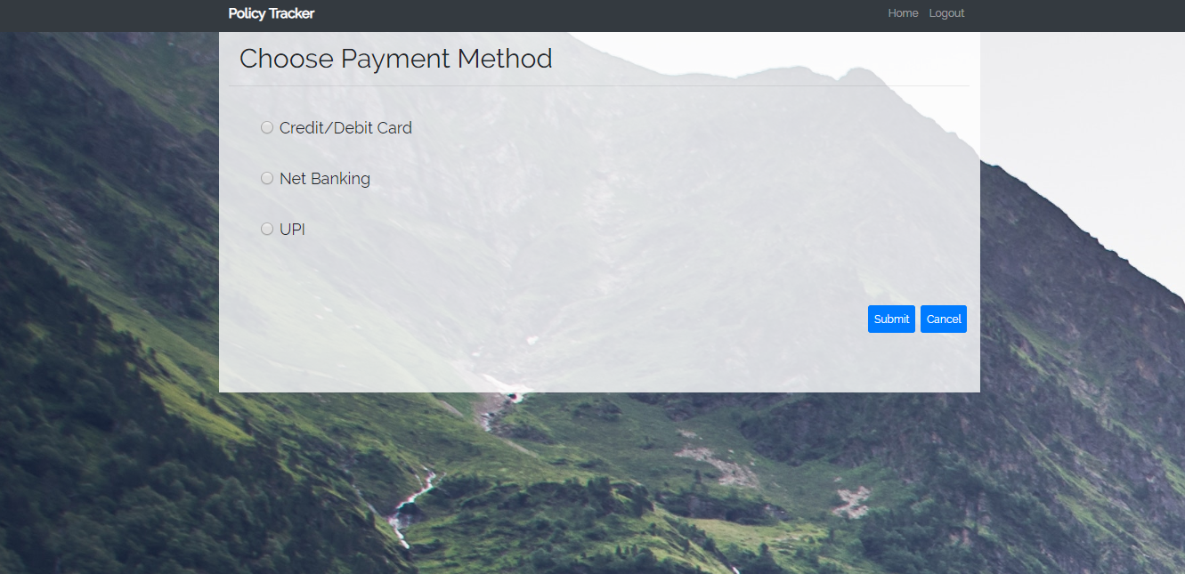
Payment Page

Slide 32


